Slide 1
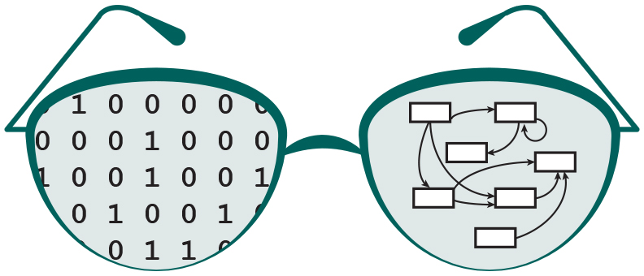

GRNsight v2: a web application for visualizing models of small gene regulatory networks
Eileen J. Choe, Nicole A. Anguiano, Anindita Varshneya, Mihir Samdarshi, Yeon-Soo Shin, Edward B. Bachoura, John David N. Dionisio, and Kam D. Dahlquist
Department of Electrical Engineering and Computer Science
Department of Biology
Loyola Marymount University
Saturday, October 28, 2017
SWE Rapid Talk - Undergraduate

Slide 2
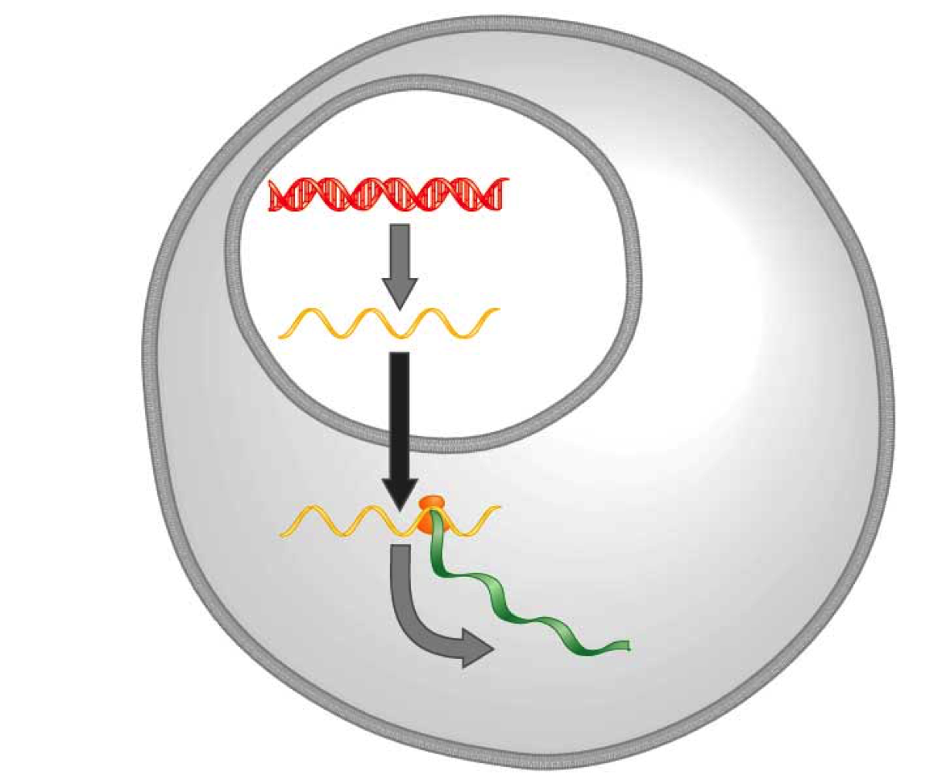
Introduction
A gene regulatory network (GRN) controls the level of expression of genes and proteins
Transcription factors activate or repress expression.
To understand GRNs we want to quantify the weight values of these regulatory relationships
DNA
Transcription
mRNA
Translation
Protein
Gene regulatory process
Notes:
A GRN’s mechanism of control is transcription factors…

Slide 3
GRNmap models the dynamics of GRNs to estimate weight parameters (w)
Introduction
Magnitude of weights represent the influence of the transcription factor on its target gene
Positive weights = activation of gene expression.
Negative weights = repression of gene expression.
GRNmap differential equation
Notes:
Weights represent the magnitude and sign of regulatory relationships.
Positive weights mean activation of gene expression.
Negative weights mean repression of gene expression.

Slide 4
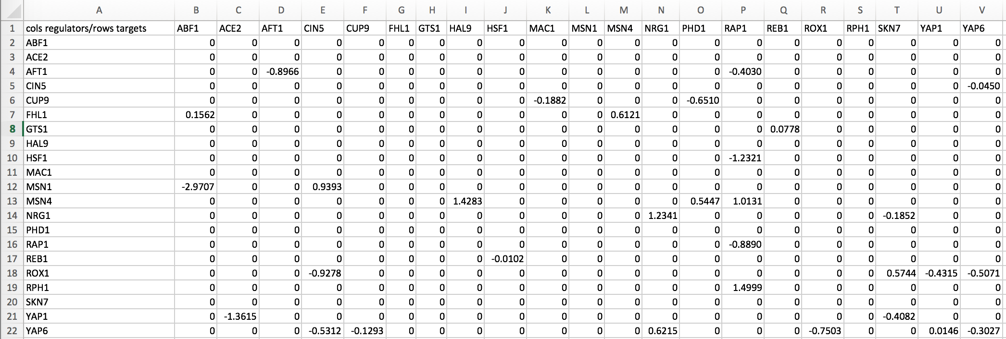
GRNmap outputs Excel spreadsheets, with estimated weight parameters
Introduction
21 gene, 31 edge weighted network output from GRNmap

Slide 5
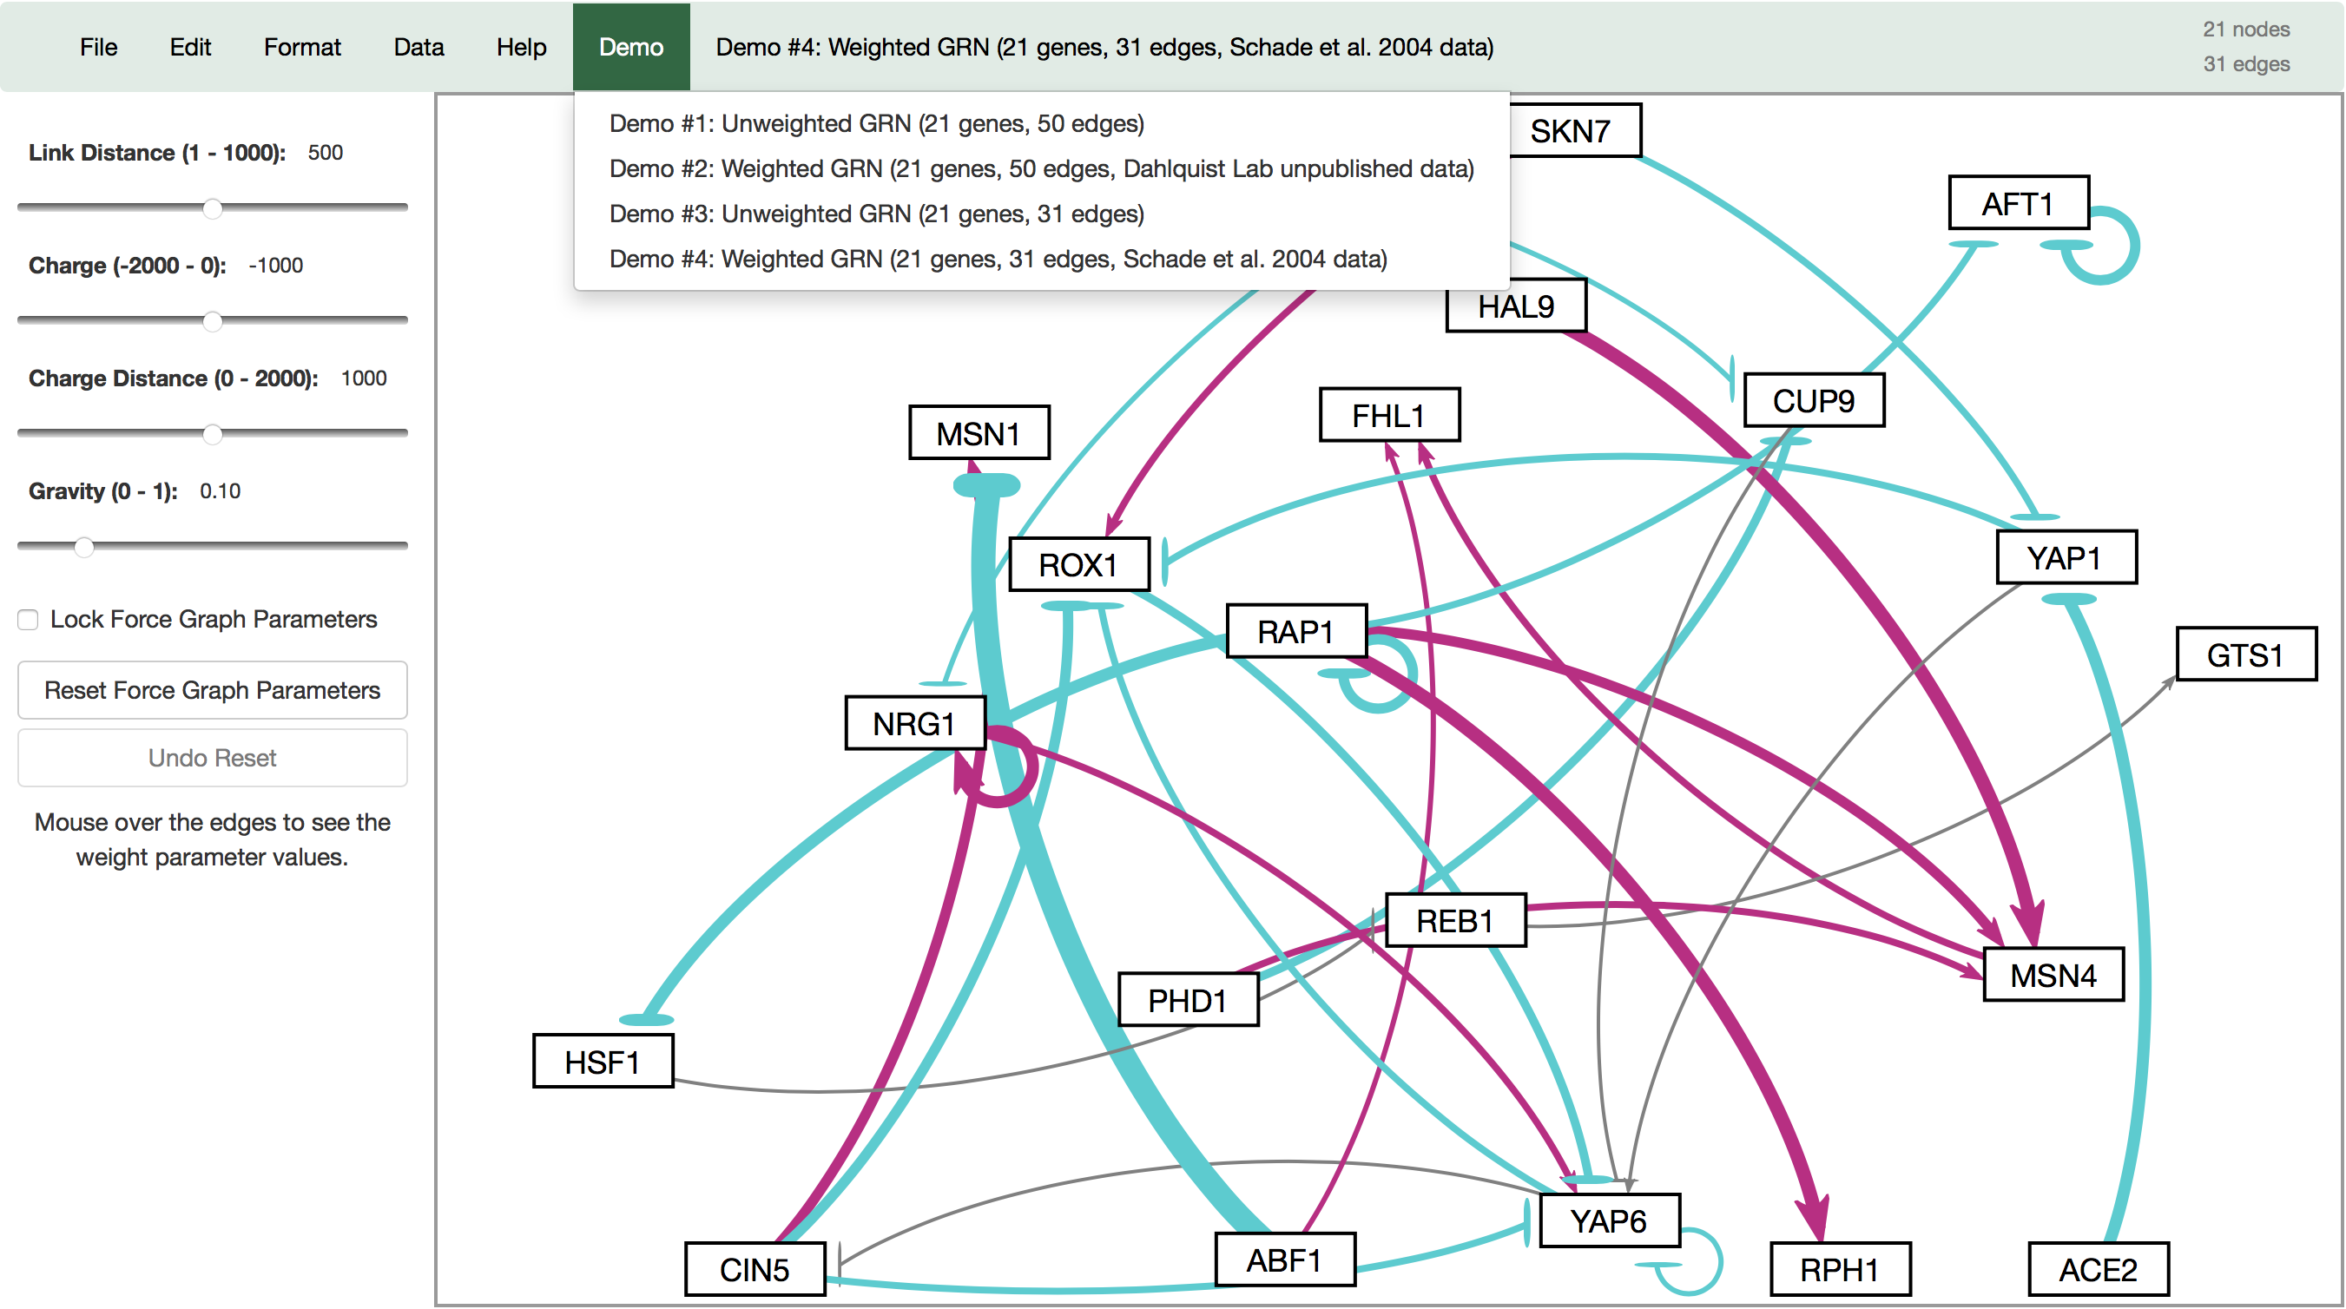
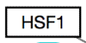
GRNsight automatically produces visualizations of weighted networks from adjacency matrix inputs
Introduction
Screenshot of GRNsight v1, released Aug 2016
Key:
Our objective is to develop GRNsight v2, with expanded visual & analytic features
gene
activation
repression
weak influence
Exists as a web application
Optimized for small- to medium-scale graphs
Automatically lays out weighted network graphs
Easy to use, and easily interpretable visualizations
Notes:
Our solution is GRNsight, a web application which automatically produces visualizations of weighted networks from adjacency matrix inputs.
In a GRNsight visualization, rectangular nodes represent genes, and the thickness of arrows represent the strength of regulatory relationships.
The interface on the left panel, allows the user to modify force graph parameters, which apply physics simulation to the graph.
From user feedback of GRNsight v1, our research objective was to expand GRNsight’s visual and analytic features.
In this talk I will focus on two features developed for GRNsight v2.

Slide 6
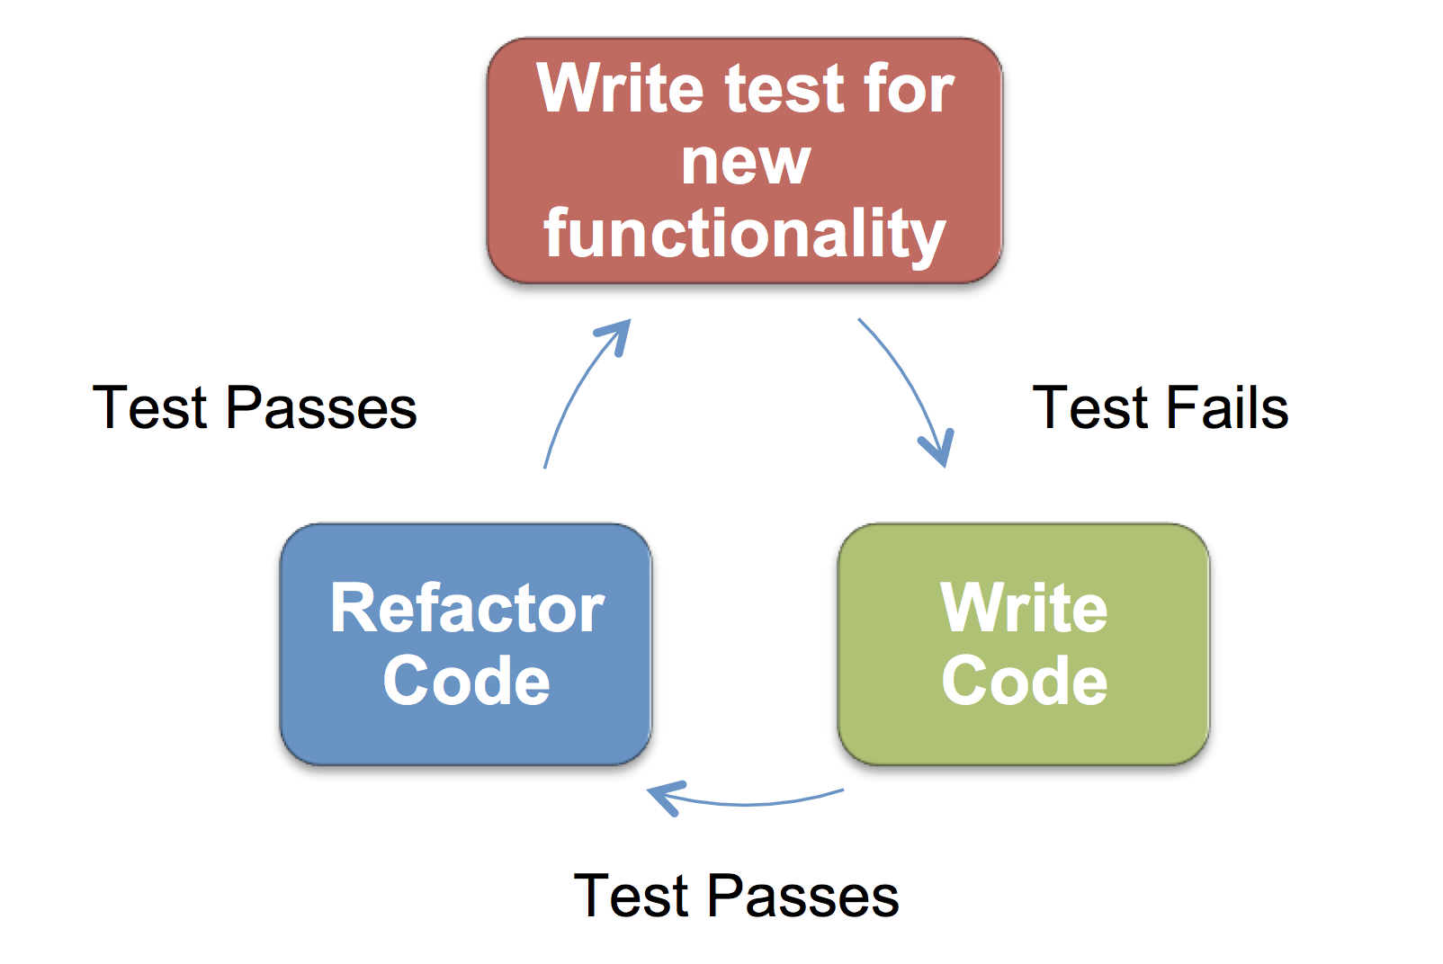



GRNsight is written in JavaScript and follows software engineering best practices
Approach
Test Passes
Test Fails
Test Passes
GRNsight technology stack
Test driven development cycle
Notes:
Client, server, and tests written in the JavaScript programming language, assisted by the following libraries displayed on the left.
GRNsight follows the software engineering best practice of test driven development, in which tests are written for new functionality prior to the feature being developed.

Slide 7
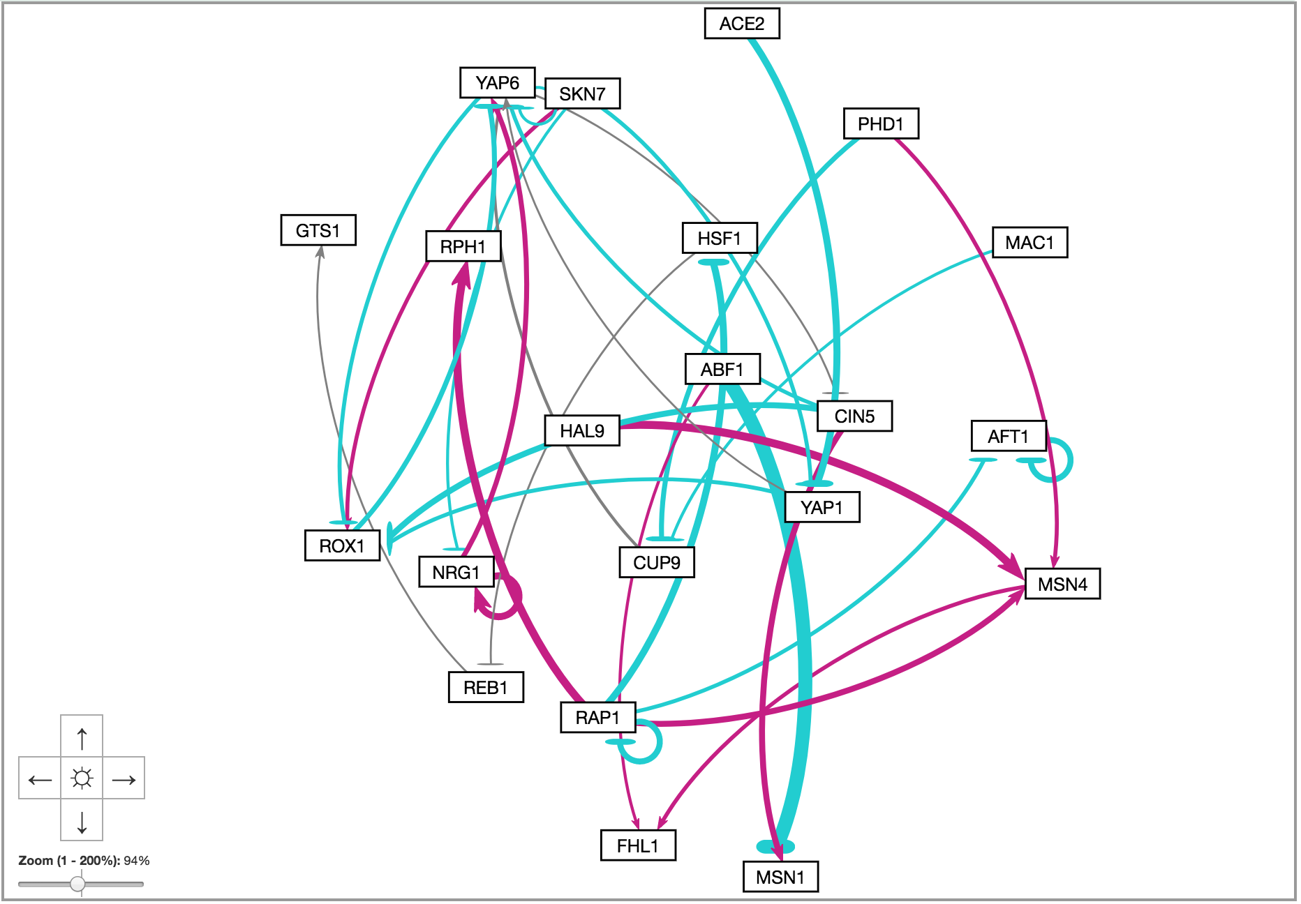
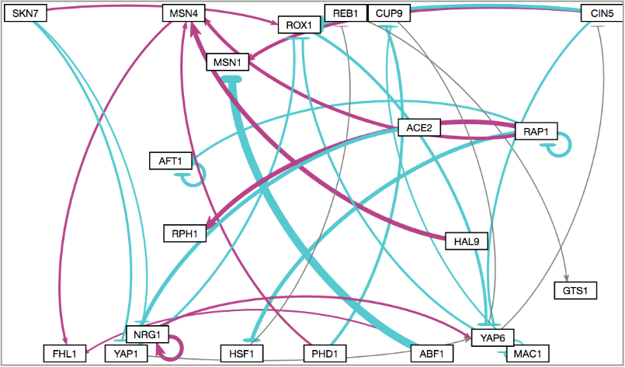
Allow graph to reach steady state
Objective #1
GRNsight v1
GRNsight v2
Nodes are restricted to the available screen area
No ability to zoom and scroll
Graph bounding box separated from viewport
Zoom and scrolling enabled
Notes:
Our first objective

Slide 8
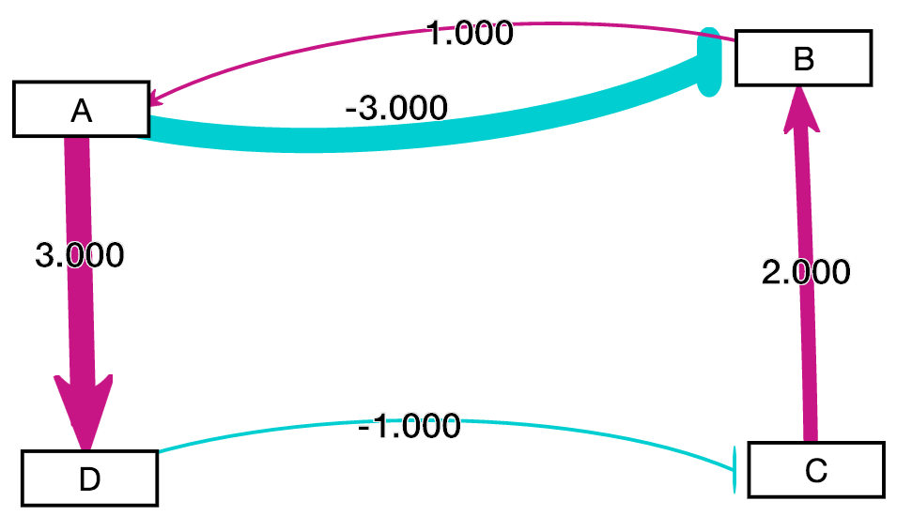
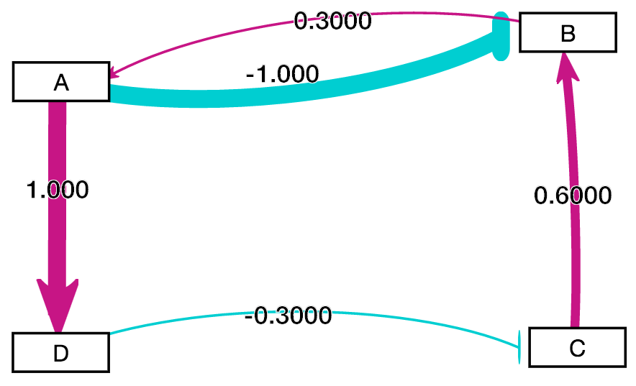
Customizable normalization factor for edge thickness
Objective #2
GRNsight v1
Visually comparing two graphs was difficult.
Normalization factor was automatically selected by maximum weight.
Circled edge thicknesses are the same although weight values are different
Notes:
Our second objective was to allow the user to customize the normalization factor for edge thickness.
The motivating problem in v1 was that visually comparing two graphs was difficult
For example, in the two graphs shown below, the circled edges with different weight values have the same thickness
This occurs because the normalization factor was automatically selected by maximum weight

Slide 9
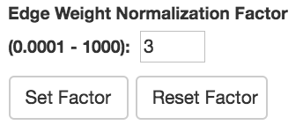
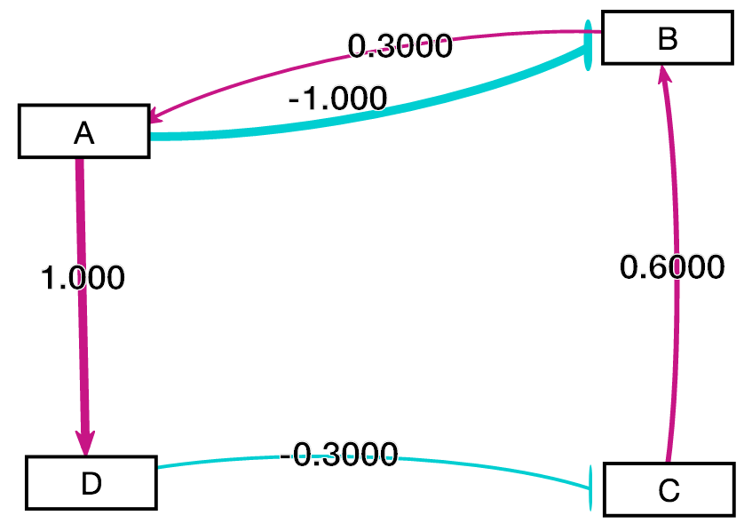
Customizable normalization factor for edge thickness
Objective #2
GRNsight v2
Allows user to set normalization factor using user interface.
Edge thicknesses can be rendered on the same scale.
Facilitates accurate visual comparison.
Normalization factor User Interface
Circled edge thicknesses are different when weight values are different
Notes:
We’ve solved this problem in GRNsight v2 by allowing users to set a custom normalization factor using the user interface screenshotted on the right
The two graphs are the same as those on the previous slide, except their edge thicknesses are now rendered on the same scale.
This facilitates accurate visual comparison

Slide 10
GRNsight v2 improves the interpretation of models of gene regulatory networks
Conclusion
GRNsight has general applicability for visualizing network graphs across different domains.
Future work: color the nodes to visualize temporal gene expression data
GRNsight application and code are available under the open source BSD license
http://dondi.github.io/GRNsight/
https://github.com/dondi/GRNsight

Slide 11
Backup Slides

Slide 12
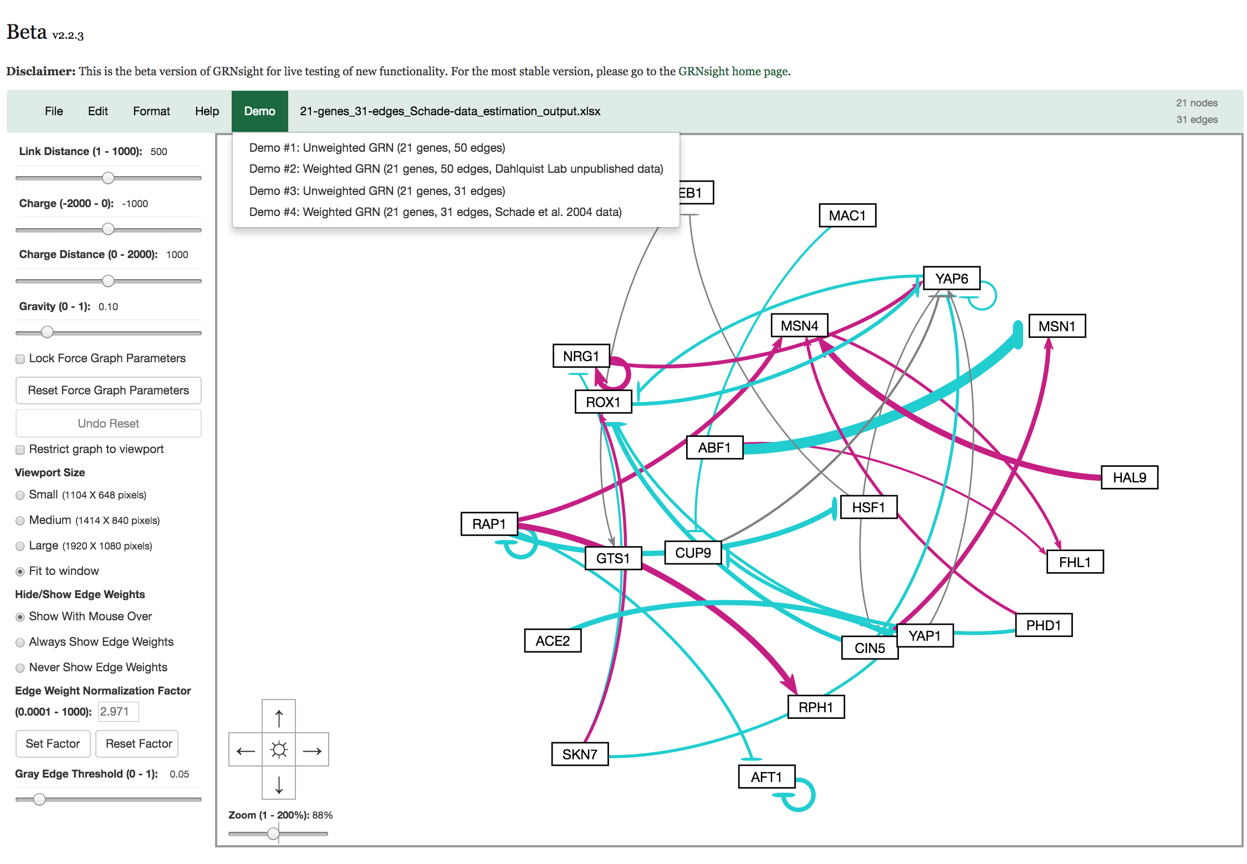
GRNsight v2.2.3 (beta) Screenshot

Slide 13
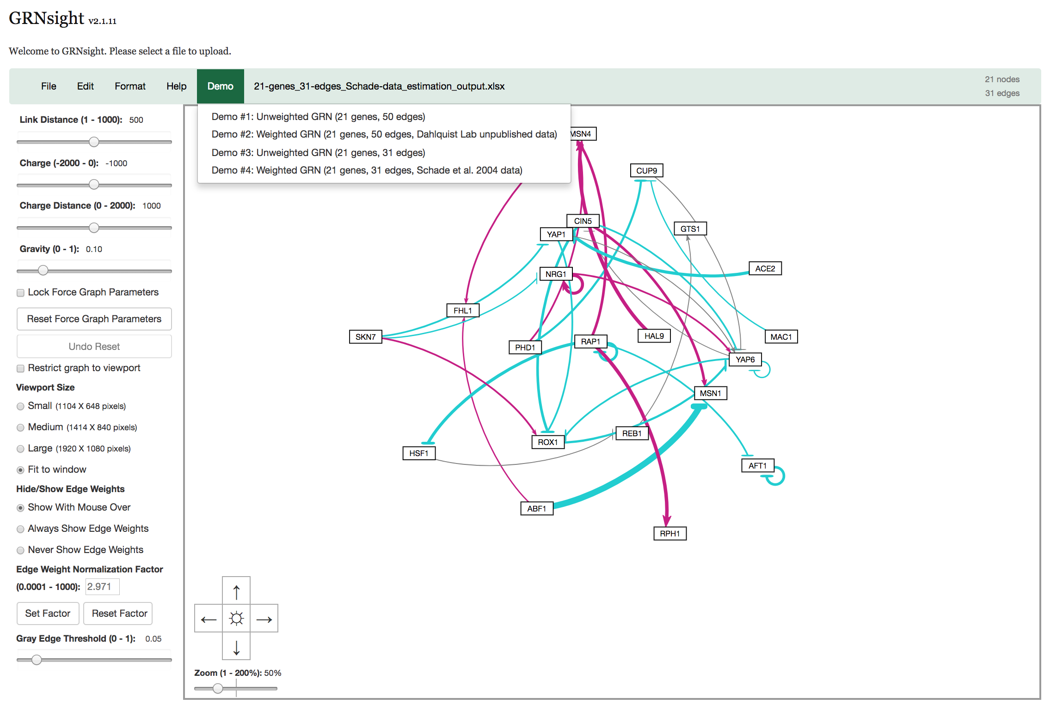
GRNsight v2.1.11 (master) Screenshot

